Slide 1
Operators: Arithmetic, Relational, Logical, Assignment

Slide 2
Operators
The different operators are:
Arithmetic
Relational
Logical
Increment and Decrement
Bitwise
Assignment
Conditional

Slide 3
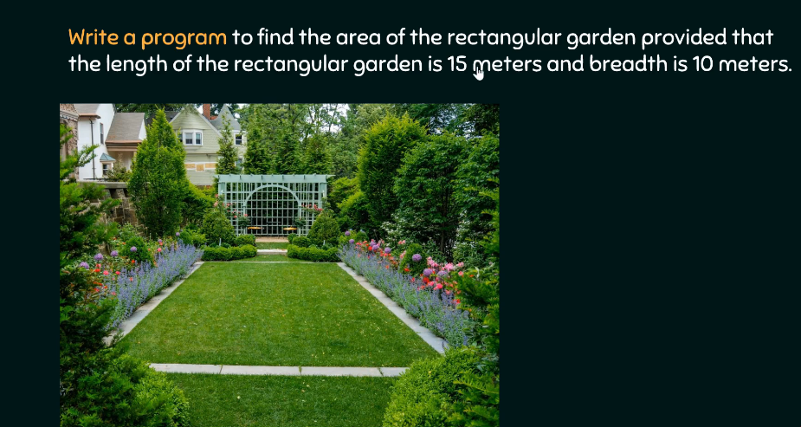

Slide 4
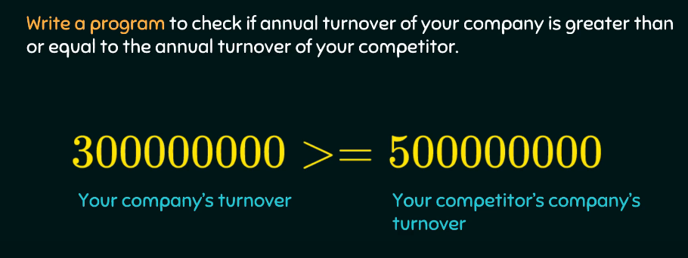

Slide 5
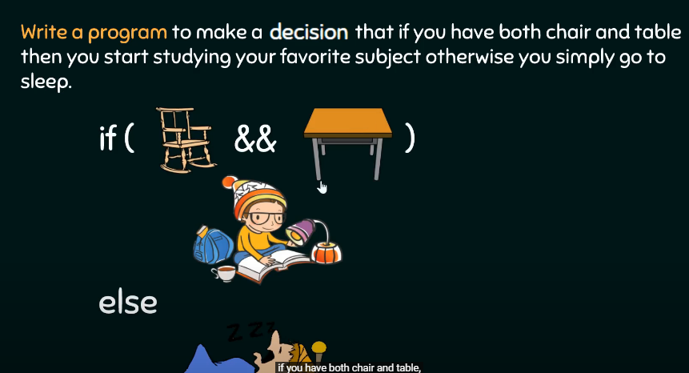

Slide 6
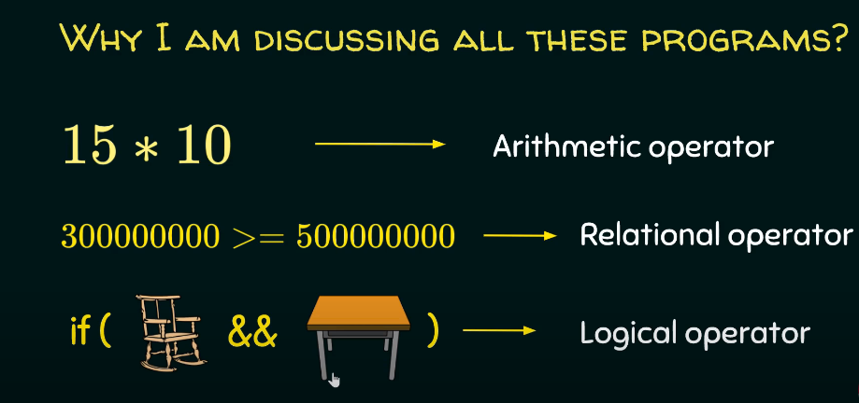

Slide 7
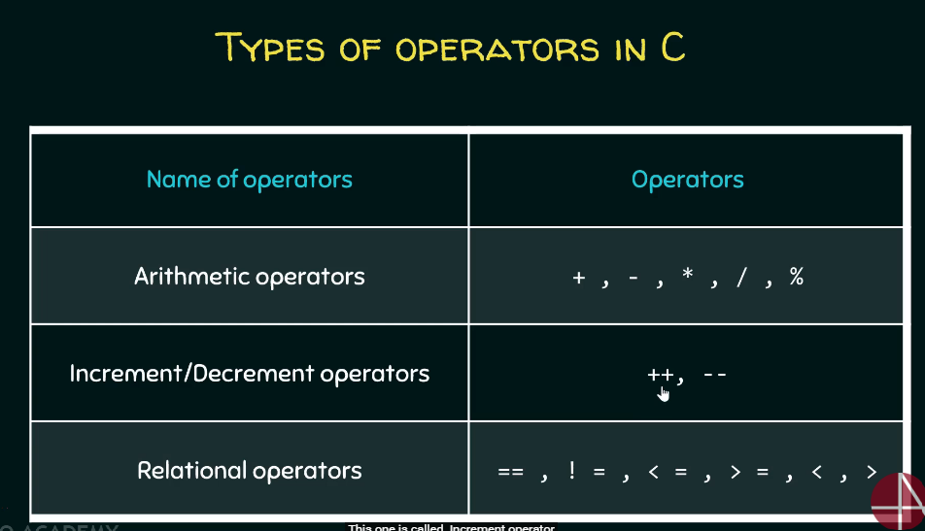

Slide 8
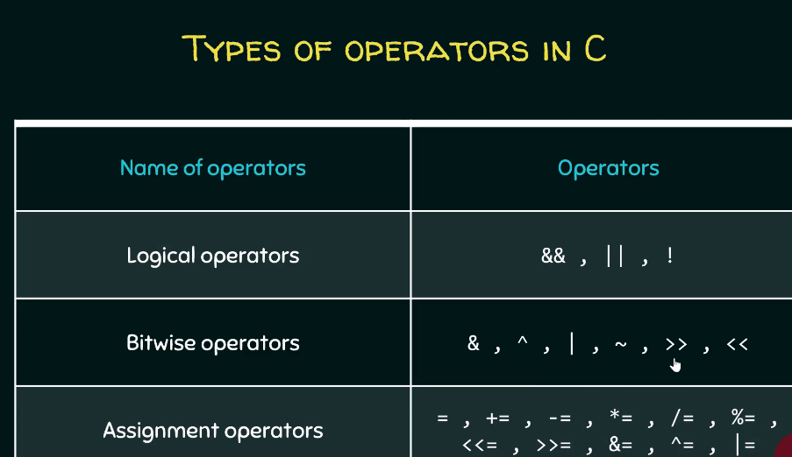

Slide 9
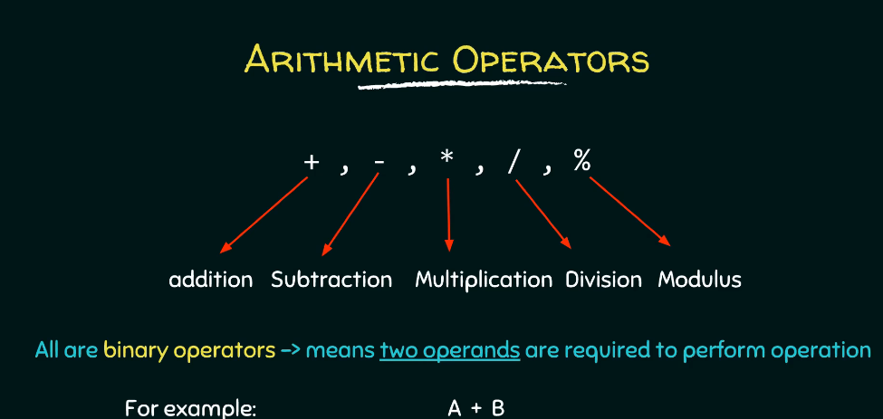

Slide 10
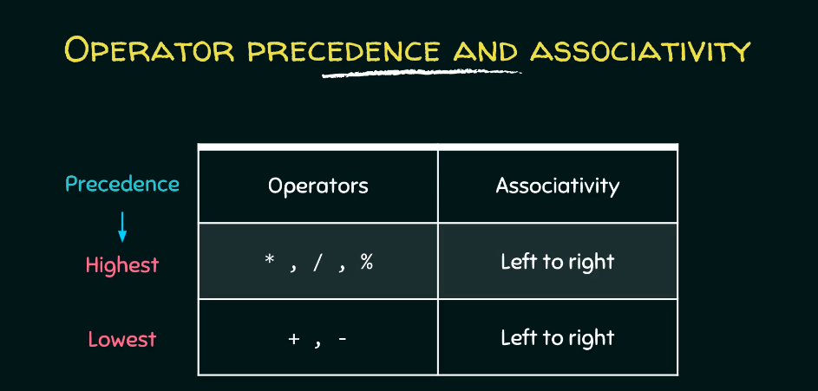
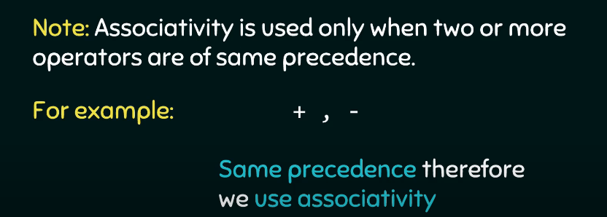

Slide 11
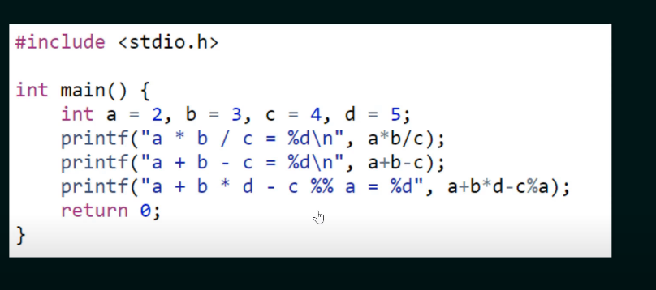

Slide 12
Arithmetic Operators
The binary arithmetic operators are +, -, *, / and the modulus operator %.
The / operator when used with integers truncates any fractional part i.e. E.g. 5/2 = 2 and not 2.5
Therefore % operator produces the remainder when 5 is divided by 2 i.e. 1
The % operator cannot be applied to float or double
E.g. x % y wherein % is the operator and x, y are operands

Slide 13

The unary minus operator
#include <stdio.h>
int main ()
{
int a = 25;
int b = -2;
printf(“%d\n”,-a);
printf(“%d\n”,-b);
return 0;
}
Output ?

Slide 14
The unary minus operator
#include <stdio.h>
int main ()
{
int a = 25;
int b = -2;
printf(“%d\n”,-a);
printf(“%d\n”,-b);
return 0;
}
Output:
-25
2

Slide 15
Working with arithmetic expressions
Basic arithmetic operators: +, -, *, /, %
Precedence: One operator can have a higher priority, or precedence, over another operator. The operators within C are grouped hierarchically according to their precedence (i.e., order of evaluation)

Slide 16
Working with arithmetic expressions
Operations with a higher precedence are carried out before operations having a lower precedence.
High priority operators * / % …
Low priority operators + - …
Example: * has a higher precedence than +
a + b * c → a+(b*c)
If necessary, you can always use parentheses in an expression to force the terms to be evaluated in any desired order.

Slide 17
Working with arithmetic expressions
Associativity: Expressions containing operators of the same precedence are evaluated either from left to right or from right to left, depending on the operator. This is known as the associative property of an operator
Example: + has a left to right associativity
For both the precedence group described above, associativity is “left to right”.

Slide 18
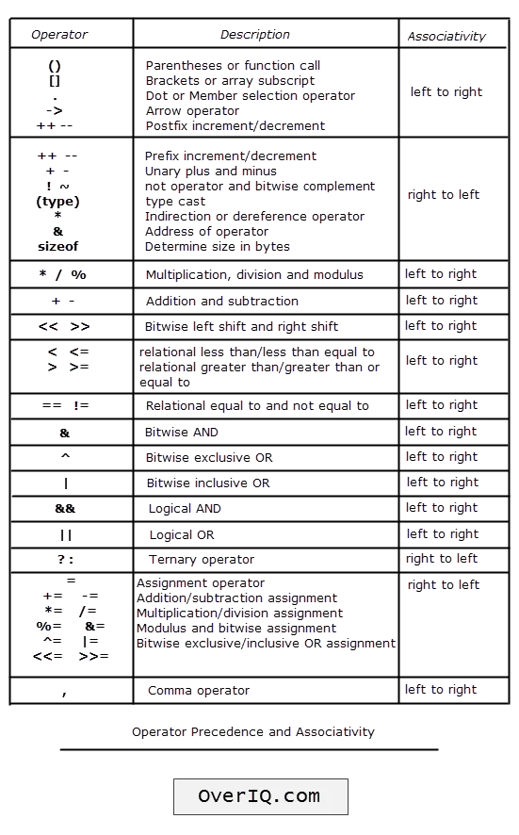
Summary of Operators

Slide 19
Working with arithmetic expressions
#include <stdio.h>
int main ()
{
int a = 100;
int b = 2;
int c = 25;
int d = 4;
int result;
result = a * b + c * d; //Precedence
printf(“%d\n”,result);
result = a = (b + c * d);//Associativity
printf(“%d\n”,result);
return 0;
}
Output:
300
102

Slide 20
Increment and Decrement Operators
++ and -- operator as prefix and postfix
If you use the ++ operator as a prefix like: ++var, the value of var is incremented by 1; then it returns the value.
If you use the ++ operator as a postfix like: var++, the original value of var is returned first; then var is incremented by 1.
#include <stdio.h>
int main() {
int var1 = 5, var2 = 5;
// 5 is displayed, Then, var1 is increased to 6.
printf("%d\n", var1++);
// var2 is increased to 6 , Then, it is displayed.
printf("%d\n", ++var2);
return 0;
}
Output:
5
6

Slide 21
Increment and Decrement Operators
#include <stdio.h>
int main()
{
int a = 10, b = 100;
float c = 10.5, d = 100.5;
printf("++a = %d \n", ++a);
printf("--b = %d \n", --b);
printf("++c = %f \n", ++c);
printf("--d = %f \n", --d);
return 0;
}
Output:
++a = 11
--b = 99
++c = 11.500000
--d = 99.500000

Slide 22
Increment and Decrement Operators: Example
What will be the output of the following C code?
#include <stdio.h>
int main()
{
int a = 1, b = 1, c;
c = a++ + b;
printf(“a=%d, b=%d, c=%d", a, b,c);
}
Output:
a = 2, b = 1, c=2

Slide 23
Increment and Decrement operators
Prefix Mode
Postfix Mode
Ex:
m=5;
y=++m; Prefix Mode
In this case, the value of y and m would be 6.
Prefix operator ++ appears before the variable.
Ex:
m=5;
y=m++; Postfix Mode
Here y continues to be 5. Only m changes to 6.
Postfix operator ++ appears after the variable
Notes:
++x and --y are called prefix mode, that means the increment or decrement operators modify their operand before it is used.
x++ and y-- are called postfix mode, the increment or decrement operators modify their operand after it is used. Remember the before used and after used words.
For example:
Postfix mode:
x = 10;
y = x++;
After these statements are executed, x = 11, y has the value of 10, the value of x was assigned to y, and then x was incremented.
Prefix mode:
y = 10;
y = ++x;
Both y and x having the value of 11, x is incremented, and then its value is assigned to y.

Slide 24
Increment and Decrement operators
Don’ts:
Attempting to use the increment or decrement operator on an expression other than a modifiable variable name or reference.
Example:
++(5) is a syntax error
++(x + 1) is a syntax error

Slide 25
Relational operators
Operator | Meaning
== | Is equal to
!= | Is not equal to
< | Is less than
<= | Is less or equal
> | Is greater than
>= | Is greater or equal
The relational operators have lower precedence than all arithmetic operators:
a < b + c is evaluated as a < (b + c)
ATTENTION !
the “is equal to” operator == and the “assignment” operator =
ATTENTION !
When comparing floating-point values, Only < and > comparisons make sense !

Slide 26
Relational operators
An expression such as a < b containing a relational operator is called a relational expression.
The value of a relational expression is one, if the specified relation is true and zero if the relation is false.
E.g.:
10 < 20 is TRUE
20 < 10 is FALSE
A simple relational expression contains only one relational operator and takes the following form.
ae1 relational operator ae2
ae1 & ae2 are arithmetic expressions, which may be simple constants, variables or combinations of them.
Notes:
Operator Symbol Means Example
Equal == Is operand 1 equal to operand 2? x == y
Greater than > Is operand 1 greater than operand 2? x > y
Less than < Is operand 1 less than operand 2? x < y
Greater than >= Is operand 1 greater than or equal to operand 2? x >= y
Less than <= Is operand 1 less than or equal to operand 2? x <= y
Not equal != Is operand 1 not equal to operand 2? x != y

Slide 27
Relational operators
The arithmetic expressions will be evaluated first & then the results will be compared. That is, arithmetic operators have a higher priority over relational operators. > >= < <= all have the same precedence and below them are the next precedence equality operators i.e. == and !=
Suppose that i, j and k are integer variables whose values are 1, 2 and 3 respectively.
Expression Interpretation Value
i<j
(i+j)>=k
(j+k)>(i+5)
k!=3
j==2
true 1
true 1
false 0
false 0
true 1

Slide 28
Logical operators
Truth Table
op-1 op-2 value of expression
op-1&&op-2 op-1||op-2
Non-zero Non-zero 1 1
Non-zero 0 0 1
0 Non-zero 0 1
0 0 0 0
Operator | Symbol | Example
AND | && | expression1 && expression2
OR | || | expression1 || expression2
NOT | ! | !expression1
The result of logical operators is always either 0 (FALSE) or 1 (TRUE)

Slide 29
Logical operators
Expressions | Evaluates As
(5 == 5)&&(6 != 2) | True (1) because both operands are true
(5 > 1) || (6 < 1) | True (1) because one operand is true
(2 == 1)&&(5 ==5) | False (0) because one operand is false
! (5 == 4) | True (1) because the operand is false
!(FALSE) = TRUE !(TRUE) = FALSE

Slide 30
Logical operators
#include <stdio.h>
int main()
{
int a = 5, b = 5, c = 10, result;
result = (a == b) && (c > b);
printf("(a == b) && (c > b) is %d \n", result);
result = (a == b) && (c < b);
printf("(a == b) && (c < b) is %d \n", result);
result = (a == b) || (c < b);
printf("(a == b) || (c < b) is %d \n", result);
result = (a != b) || (c < b);
printf("(a != b) || (c < b) is %d \n", result);
result = !(a != b);
printf("!(a != b) is %d \n", result);
result = !(a == b);
printf("!(a == b) is %d \n", result);
return 0;
}
Output
(a == b) && (c > b) is 1
(a == b) && (c < b) is 0
(a == b) || (c < b) is 1
(a != b) || (c < b) is 0
!(a != b) is 1
!(a == b) is 0

Slide 31
The assignment operators
The C language permits you to join the arithmetic operators with the assignment operator using the following general format: op=, where op is an arithmetic operator, including +, –, *, /, and %.
Example:
count += 10;
Equivalent to:
count=count+10;
Example: precedence of op=:
a /= b + c
Equivalent to:
a = a / (b + c)

Slide 32
Bitwise operators
In arithmetic-logic unit (which is within the CPU), mathematical operations like: addition, subtraction, multiplication and division are done in bit-level.
Operators Meaning of operators
& Bitwise AND
| Bitwise OR
^ Bitwise XOR
~ Bitwise complement
<< Shift left
>> Shift right

Slide 33
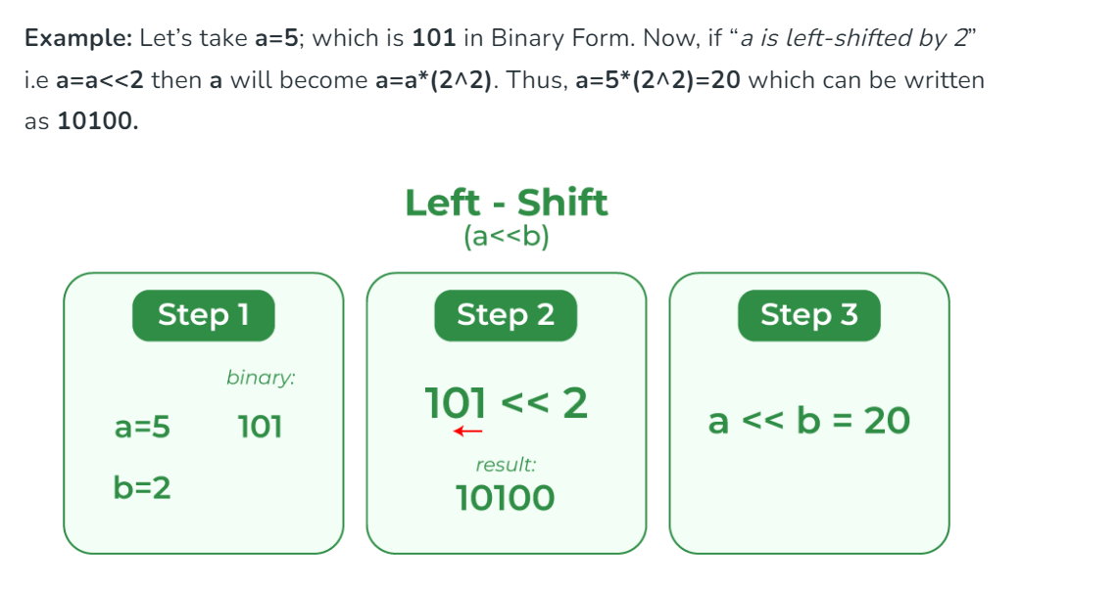

Slide 34
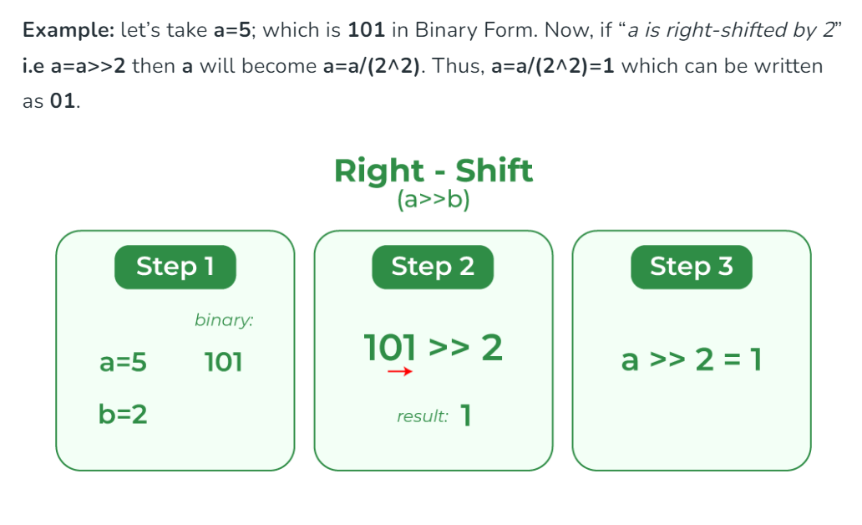

Slide 35
#include <stdio.h>
// Driver code
int main()
{
// a = 5(00000101), b = 9(00001001)
unsigned char a = 5, b = 9;
// The result is 00001010
printf("a<<1 = %d\n", (a << 1));
// The result is 00010010
printf("b<<1 = %d", (b << 1));
// The result is 00000010
printf("\n a>>1 = %d\n", (a >> 1));
// The result is 00000100
printf("b>>1 = %d", (b >> 1));
return 0;
}

Slide 36
Bitwise Operators Examples
12 = 00001100 (In Binary)
25 = 00011001 (In Binary)
Bit Operation of 12 and 25
00001100
& 00011001
______
00001000 = 8 (In decimal)
12 = 00001100 (In Binary)
25 = 00011001 (In Binary)
Bitwise OR Operation of 12 and 25
00001100
| 00011001
________
00011101 = 29 (In decimal)
12 = 00001100 (In Binary)
25 = 00011001 (In Binary)
Bitwise XOR Operation of 12 and 25
00001100
^ 00011001
________
00010101 = 21 (In decimal)
35 = 00100011 (In Binary)
Bitwise complement Operation of 35
~ 00100011
________
11011100 = 220 (In decimal)
Bitwise complement of any number N is -(N+1)

Slide 37
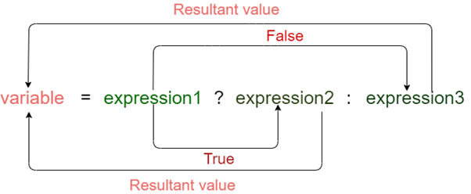
Conditional Operator
The conditional operator is also known as a ternary operator. The conditional statements are the decision-making statements which depends upon the output of the expression. It is represented by two symbols, i.e., '?' and ‘:’.
Syntax of a conditional operator
Expression1? expression2: expression3;

Slide 38
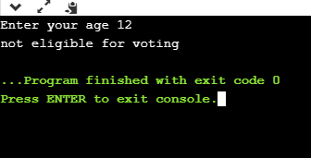
Conditional Operator
#include <stdio.h>
int main()
{
int age; // variable declaration
printf("Enter your age");
scanf("%d",&age); // taking user input for age variable
(age>=18)? (printf("eligible for voting")) : (printf("not eligible for voting"));
return 0;
}

Slide 39
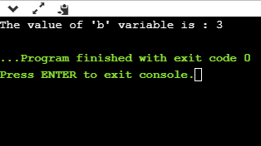
Conditional Operator
#include <stdio.h>
int main()
{
int a=5,b; // variable declaration
b=((a==5)?(3):(2)); // conditional operator
printf("The value of 'b' variable is : %d",b);
return 0;
}

Slide 40
Thank You!!

